Slide 1
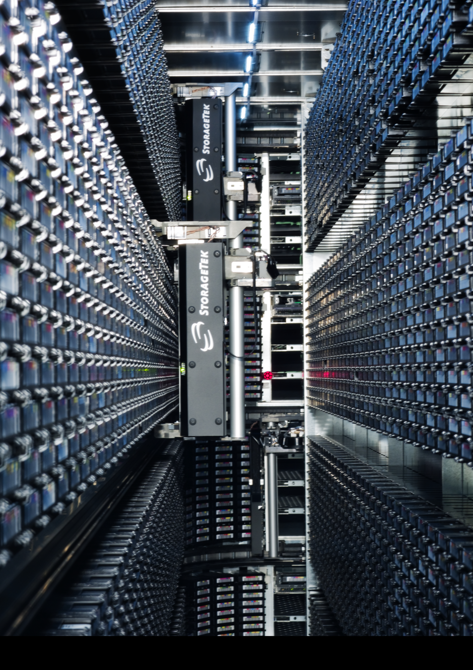

DSS
Tape write efficiency improvements in CASTOR
CERN
IT
Data Storage
Services
Department
Primary author: MURRAY Steven (CERN) Co-authors: BAHYL Vlado (CERN), CANCIO German (CERN), CANO Eric (CERN),
KOTLYAR Victor (Institute for High Energy Physics (RU)), LO PRESTI Giuseppe (CERN), LO RE Giuseppe (CERN) and PONCE Sebastien (CERN)
The CERN Advanced STORage manager (CASTOR) is used to archive to tape the physics data of past and present physics experiments. The current size of the tape archive is approximately 61PB. For reasons of physical storage space, all of the tape resident data in CASTOR are repacked onto higher density tapes approximately every two years. The performance of writing files smaller than 2GB to tape is critical in order to repack all of the tape resident data within a period of no more than 1 year.
Original architecture before improved write efficiency – 3 flushes per file
Drive scheduler
1. Mount tape
3. Write header file
4. Flush buffer
5. Write user file
6. Flush buffer
7. Write trailer file
8. Flush buffer
3 flushes
≈ 5 seconds
≈ 1.2 GB that could
have been written
Legacy tape transfer-manager
2. File info
Legacy tape reader/writer
9. Wrote file
Architecture after first deployment – 1 flush per file
Minor modification to the legacy tape reader/writer
1 flush
≈ 1.667 seconds
≈ 400 MB that could
have been written
Drive scheduler
1. Mount tape
3. Write header file
4. Write user file
5. Write trailer file
6. Flush buffer
Legacy tape transfer-manager
2. File info
Legacy tape reader/writer
7. Wrote file
Architecture of second deployment – 1 flush per N GB
Protocol bridge allows old and new installations to co-exist
Legacy tape transfer-manager replaced by the tape gateway
Unlike the legacy tape transfer-manager, multiple tape-gateways can be ran in parallel for redundancy
More efficient bulk-protocol
Drive scheduler
1. Mount tape
Tape
gateway
2. File info for N files
Protocol bridge
For N files or data loop
3. Write header file
4. Write user file
5. Write trailer file
End loop
6. Flush buffer
After N files, 1.667 seconds spent flushing is negligible
7. Wrote N files
Legacy tape transfer-manager
Legacy tape reader/writer
Results
Implementing the delayed flushing of the tape-drive data-buffer
Implemented using immediate tape-marks from version 2 of the SCSI standard
CERN worked with the developer of the SCSI tape-driver for Linux to implement
support for immediate tape-marks
Support for immediate tape-marks is now available as an official SLC5
Kernel-patch and is in the vanilla Linux-Kernel as of version 2.6.37
Methodology used when modifying legacy code
The legacy tape reader/writer is critical for the safe storage and retrieval of data
Modifications to the legacy tape reader/writer were kept to a bare minimum
It is difficult to test new code within the legacy tape reader/writer, therefore
unit-tests were used to test the new code separately
Used the unit-testing framework for C++ named CPPUnit
Developed 189 unit-tests so far
Tests range from simple object instantiation through to testing TCP/IP
application-protocols
Average file-size ≈ 290 MB
Overall
increase
≈ ×10
Efficiency increase
≈ ×3 for average file size
CERN IT Department
CH-1211 Genève 23
Switzerland
http://cern.ch/it-dss

